Slide 1
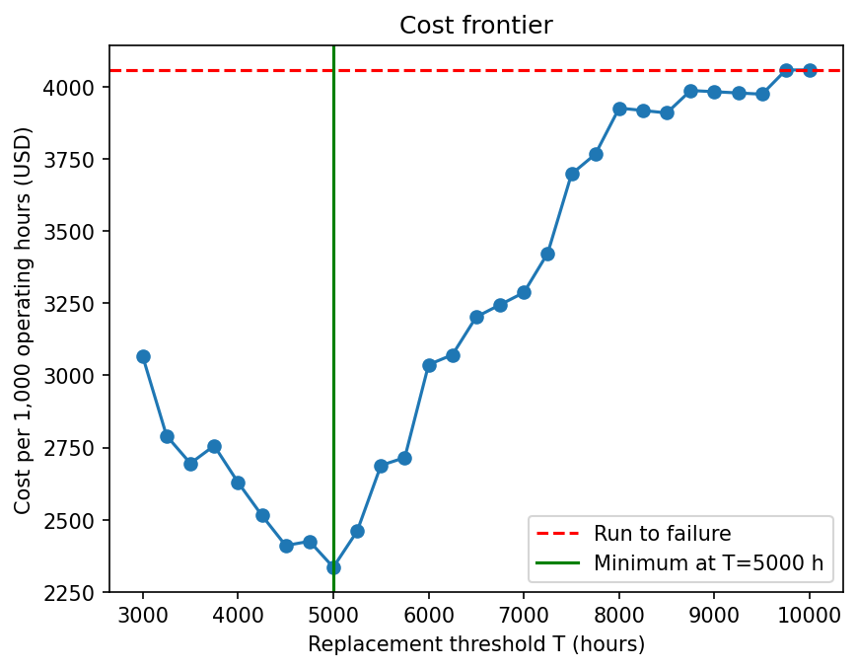
RECOMMENDATIONS AND EVIDENCE
Replacing needles every 5,000 operating hours yields a 42% lower operating cost.
Cost per 1,000 h: $2,335 with scheduled replacement, vs. $4,058 running until failure.
Failures over 5 years: from 30 to 4
Acceptable replacement range: 4,250 – 5,000 h
Back test on unseen machines: 33-44% savings
Acoyani Garrido Sandoval, Israel Rivera Guzmán, Margarita Flores Ruiz, Oscar Gutiérrez Godoy & Emilio Valerio Padilla

Slide 2
Methods, models and risks
Validated approach, with known limits
Approach: Cleaned 2,605 to 2,600 records (audit). EDA: risk rises with hours. 9 models tested. Cost simulation from 3,000 to 10,000 h.
Sensitivity: Failure cost $10k / $20k / $40k -> best T 5,000 / 5,000 / 4,500 h
Risks:
  Censored lifetimes
  Only 30 failures
  History replay assumes non-changing conditions
Next steps: Survival analysis and a pilot
Logistic test AUC | 0.906
LDA | 0.905
SVM | 0.807
Regression | No model beats mean
Acoyani Garrido Sandoval, Israel Rivera Guzmán, Margarita Flores Ruiz, Oscar Gutiérrez Godoy & Emilio Valerio Padilla

